Slide 1

Theory of Computation
CSE ( CET2008B)
TY BTech
Unit V
Basic Introduction to Complexity

Slide 2
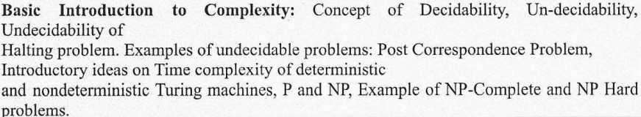
Unit V
Basic Introduction of Complexity

Slide 3

Course Objective & Course Outcomes
Course Objectives:
  To Study computing machines by describing, classifying and comparing different types of computational models.
  Encourage students to study Theory of Computability and Complexity.
Course Outcomes:
After successful completion of this course students will be able to:
Construct finite state machines to solve problems in computing
Write mathematical expressions for the formal languages
Apply well defined rules for syntax verification
Construct and analyze Push Down, Post and Turing Machine for formal languages
Express the understanding of the decidability and Undecidability problems
Express the understanding of computational complexity.

Slide 4
Text Books & Reference Books
Text Books
Michael Sipser “Introduction to the Theory of Computation” CENGAGE Learning, 3rd Edition ISBN-13:978-81-315-2529-6
Vivek Kulkarni, “Theory of Computation”, Oxford University Press,
ISBN-13: 978-0-19-808458-7
Reference Books
Hopcroft Ulman, “Introduction To Automata Theory, Languages And Computations”, Pearson Education Asia, 2nd Edition
Daniel. A. Cohen, “Introduction to Computer Theory” Wiley-India, ISBN:978-81-265-1334-5
K.L.P Mishra ,N. Chandrasekaran ,“Theory Of Computer Science (Automata, Languages and Computation)”, Prentice Hall India,2nd Edition
John C. Martin, “Introduction to Language and Theory of Computation”, TMH, 3rd Edition ISBN: 978-0-07-066048-9
Kavi Mahesh, “Theory of Computation: A Problem Solving Approach”, Wiley-India, ISBN: 978-81-265-3311-4

Slide 5
Turing Machine
A Turing Machine is represented by a 7-tuple
T = (Q, Σ, Γ, δ, q₀, q_{accept}, q_{reject}):
Q is a finite set of states
Σ is the input alphabet, where Z₀∉ Σ
Γ is the tape alphabet, a superset of Σ; Z₀ ∈ Γ
q₀ ∈ Q is the start state
q_{accept} ∈ Q is the accept state

Slide 6
Solvable and Semi-Solvable Problems
 Solvable problem: TM when applied to such a problem, always
eventually terminates with the correct “yes” or “no” answer
 A class of all such problems is called as Recursive language
 The mathematical functions that denote these type of problems are called as Total Recursive Functions
 Simple Examples - multiplication, addition, concatenation and many other
 Semi-solvable problem: TM when applied to such a problem, always eventually terminates with correct answer when answer is “yes” and may or may not terminate when the correct answer is “no”
 A class of all such problems is called as Recursively Enumerable language
 The mathematical functions that denote these type of problems are called as Partial Recursive Functions
 Simple Examples - division, factorial and many other

Slide 7
Halting Problem and Unsolvablity
The halting problem is the problem of determining, from a description of an arbitrary computer program and an input, whether the program will finish running or continue to run forever.
the halting problem is undecidable over Turing machines. It is one of the first examples of a decision problem.
For example, in pseudo code, the program:
  while (true) continue
does not halt; rather, it goes on forever in an infinite loop. On the other hand, the program
  print "Hello, world!"

Slide 8
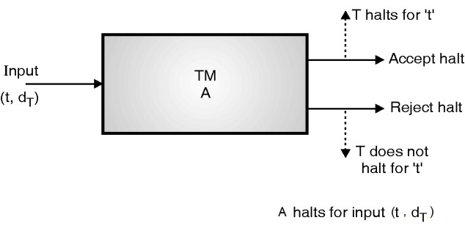
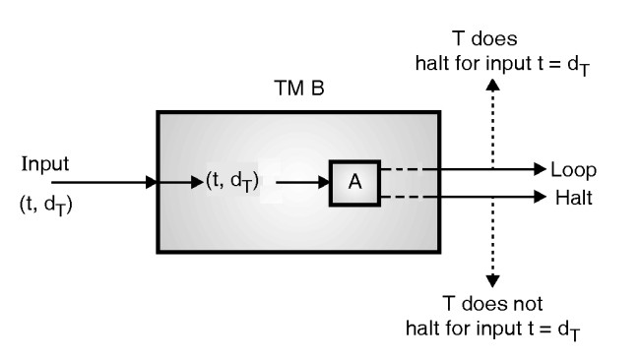
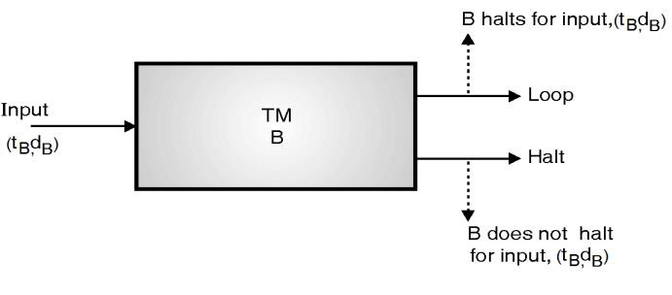
Halting Problem and Unsolvablity
 For a given input for any general TM two cases arise,
 The machine may halt after a finite number of steps
 The machine may not ever halt no matter how long it runs
 Given any TM, problem of algorithmically determining whether it ever halts or not, is called as the Halting Problem
 The halting problem is unsolvable

Slide 9
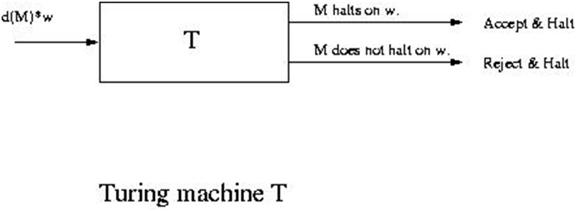
Proof :-Halting problem is undecidable
Proof by contradiction
There is a Turing machine T that will decide the halting problem.<M> this is the description of Turing machine M and string W . T write "accept" when M halts on w, and reject If M does not halts on W

Slide 10
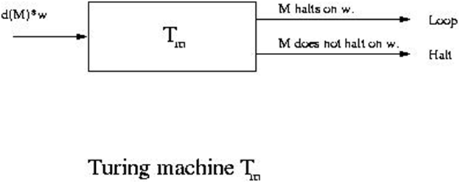
Proof :-Halting problem is undecidable
We build a Turing machine Tm and here we standardizing T so when T write yes and halt then Tm will goes into loop forever

Slide 11
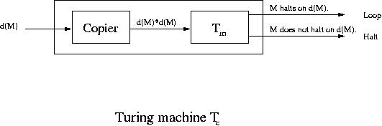
Proof :-Halting problem is undecidable
we build Tc with the help of TM. Here we take Tc as input which is the description of Turing machine M and we write it in this way d(M) now we copies it to obtain the string d(M)*d(M), where * is a symbol that break up the two copies of d(M) and then provide d(M)*d(M) to the Turing machine Tm .

Slide 12
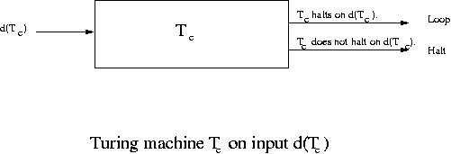
Proof :-Halting problem is undecidable
What Turing machine Tc does when a string given to it which describe Tc itself
d(Tc) is given as input to Tc it make copy of it and build the string d(Tc)*d(Tc) and allot to standardized T.so the altered T is specified a description of Tc and string d(Tc)

Slide 13

Post Correspondence Problem
First introduced by Emil Post in 1946, the Post Correspondence Problem (𝑃𝐶𝑃)
It is a well-known example of an undecidable decision problem.
The goal of the problem is to determine whether or not a given set of dominos has a match, which means that dominos from the set can be arranged in a way (with repetition) such that the top and the bottom strings are identical.

Slide 14
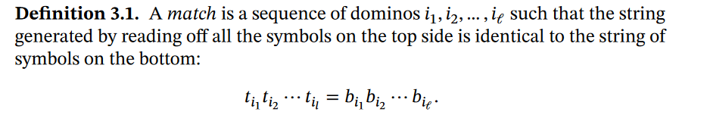
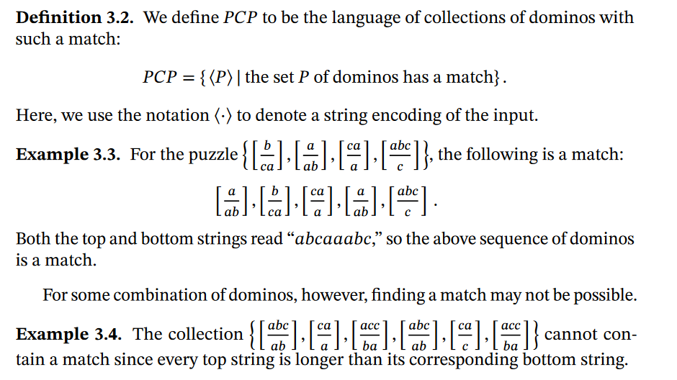
Post Correspondence Problem

Slide 15
Post Correspondence Problem
Input:
Two sets of strings
There is a Post Correspondence Solution
if there is a sequence such that:
PC-solution:

Slide 16
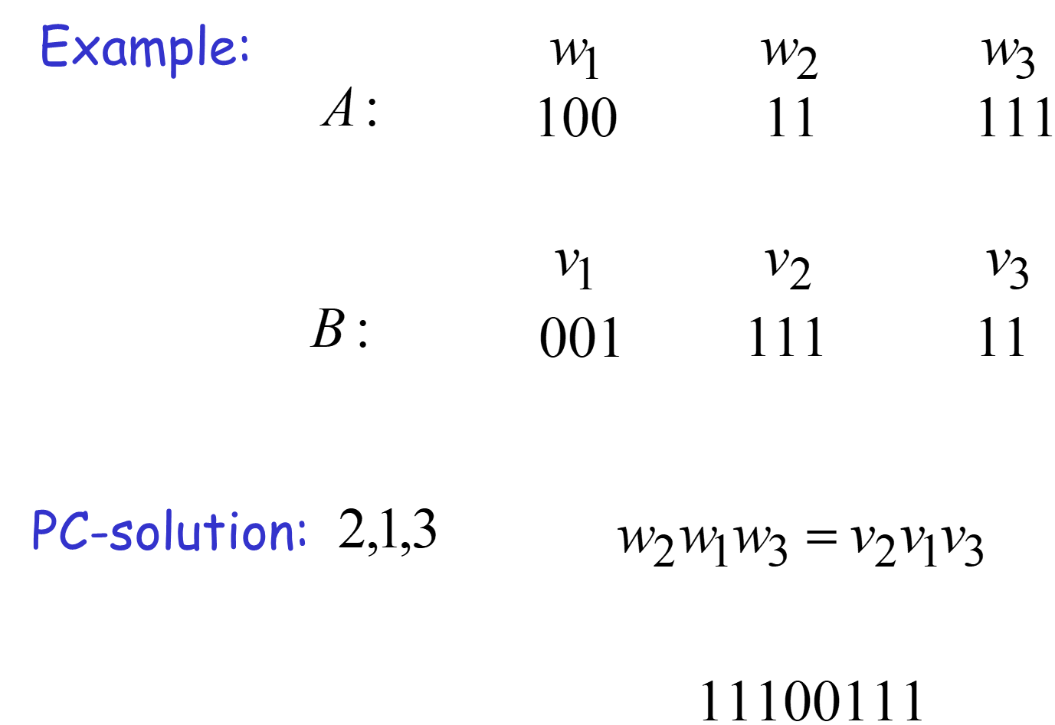
Post Correspondence Problem

Slide 17
Post Correspondence Problem

Slide 18
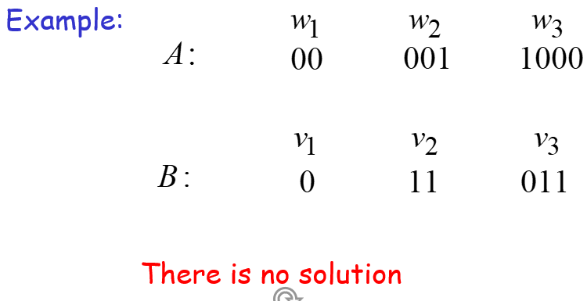
Post Correspondence Problem
Because total length of strings from B
is smaller than total length of strings from A

Slide 19
Turing Machine
Invented by Alan Turing in 1936
A simple mathematical model of a general purpose computer
It is capable of performing any calculation which can be performed by any computing machine

Slide 20
Turing Machine
Invented by Alan Turing in 1936
A simple mathematical model of a general purpose computer
It is capable of performing any calculation which can be performed by any computing machine

Slide 21
Turing Machine
Types of Problems
  Decidable
  Undecidable
Decidable : Problems that can be solvable in a reasonable(polynomial) time.
Undecidable : Some problems are intractable, as they grow large, we are unable to solve them in reasonable time

Slide 22
Complexity of TM
For a Turing machine, the time complexity refers to the measure of the number of times the tape moves when the machine is initialized for some input symbols.
The time-complexity of a NTM is defined as the maximum number of steps it uses on any branch on any input of length n.

Slide 23
Turing Machine
What constitutes reasonable time?
– Standard working definition: polynomial time
– On an input of size n the worst-case running time is O(nk) for some constant k
– O(n2), O(n3), O(1), O(n lg n), O(2n), O(nn), O(n!)
– Polynomial time: O(n2), O(n3), O(1), O(n lg n)
– Not in polynomial time: O(2n), O(nn), O(n!)
• Are all problems solvable in polynomial time?
– No: Turing’s “Halting Problem” is not solvable by any computer, no matter how much time is given.

Slide 24
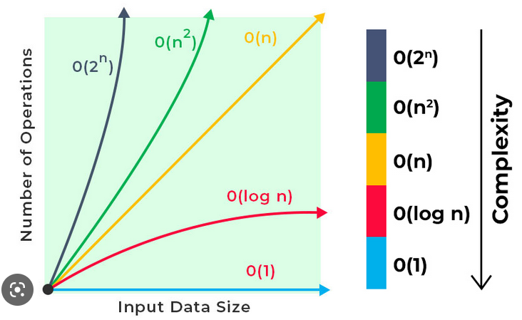
Time complexity graph

Slide 25
P, NP, NP-Hard, NP-Complete

Slide 26
The Class P (Polynomial-time)
P: the class of problems that have polynomial-time deterministic algorithms.
– That is, they are solvable in O(p(n)), where p(n) is a polynomial on n
– A deterministic algorithm is (essentially) one that always
computes the correct answer
-They are simple to solve, easy to verify and take computationally acceptable time for solving any instance of the problem. Such problems are also known as “tractable”.
-Why polynomial?
  efficient
  nice closure properties
    the sum and composition of two polynomials are always polynomials too

Slide 27
The Class P (Polynomial-time)
Searching an element in the array (O(n)),
inserting an element at the end of a linked list (O(n)),
sorting data using selection sort(O(n²)),
finding the height of the tree (O(log₂n)),
sort data using merge sort(O(nlog₂n)),
matrix multiplication O(n³).
MST

Slide 28
The Class NP(Nondeterministic Polynomial-time)
NP: the class of decision problems that are solvable in polynomial time on a nondeterministic machine (or with a nondeterministic algorithm)
– (A determinstic computer is what we know)
– A nondeterministic computer is one that can “guess” the right answer or solution
• Think of a nondeterministic computer as a parallel machine that can freely spawn an infinite number of processes
• Thus NP can also be thought of as the class of problems “whose solutions can be verified in polynomial time”
• Note that NP stands for “Nondeterministic Polynomial-time”

Slide 29
The Class NP (Non-Polynomial-time)
Travelling salesman problem (O(n!)),
Hamiltonian cycle (O(n!))
Tower of Hanoi (O(2n – 1)),
Knapsack problem (O(2n)),
Clique problem.
Vertex cover problem.

Slide 30
TSP
Given a set of cities and the distance between every pair of cities, the problem is to find the shortest possible route that visits every city exactly once and returns to the starting point.
Note the difference between Hamiltonian Cycle and TSP.
The Hamiltonian cycle problem is to find if there exists a tour that visits every city exactly once.
Here we know that Hamiltonian Tour exists (because the graph is complete) and in fact, many such tours exist, the problem is to find a minimum weight Hamiltonian Cycle.

Slide 31
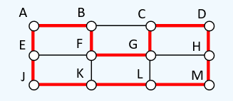
Knapsack Problem
Given a set of items, holding weights and profit values, one must determine the subset of the items to be added in a knapsack such that, the total weight of the items must not exceed the limit of the knapsack and its total profit value is maximum.
Hamiltonian cycle

Slide 32
Difference between N and NP
P problems are set of problems which can be solved in polynomial time by deterministic algorithms.
P Problems can be solved and verified in polynomial time
P problems are a subset of NP problems
All P problems are deterministic in nature
Example: Selection sort, Linear search
NP problems are problems which can be solved in nondeterministic polynomial time.
The solution to NP problems cannot be obtained in polynomial time, but if the solution is given, it can be verified in polynomial time.
NP Problems are a superset of P problems
All the NP problems are non-deterministic in nature
Example: TSP, Knapsack problem

Slide 33
Difference between P and NP
P problems are set of problems which can be solved in polynomial time by deterministic algorithms.
P Problems can be solved and verified in polynomial time
P problems are a subset of NP problems
All P problems are deterministic in nature
Example: Selection sort, Linear search
NP problems are problems which can be solved in nondeterministic polynomial time.
The solution to NP problems cannot be obtained in polynomial time, but if the solution is given, it can be verified in polynomial time.
NP Problems are a superset of P problems
All the NP problems are non-deterministic in nature
Example: TSP, Knapsack problem

Slide 34
The Class NP Hard
What does NP-hard mean?
– A lot of times you can solve a problem by reducing it to a different problem. I can reduce Problem B to Problem A if, given a solution to Problem A, I can easily construct a solution to Problem B. (In this case, "easily" means "in polynomial time”).
• A problem is NP-hard if all problems in NP are polynomial time reducible to it, ... Ex- Hamiltonian Cycle
• Every problem in NP is reducible to HC in polynomial time. Ex:- TSP is reducible to HC.
B A
Example: lcm(m, n) = m * n / gcd(m, n),
Example: TSP (the optimization problem of finding the least-cost cyclic route through all nodes of a weighted graph)
the Knapsack Problem, and the Integer Programming Problem

Slide 35
The Class NP Complete
A problem is NP-complete if the problem is
both
– NP-hard, and
– NP
Examples:
  the traveling salesman problem
  satisfiability problems
  graph-covering problems

Slide 36
NP hard and NP Complete
If R is polynomial-time reducible to Q,
we denote this R <=p Q
Definition of NP-Hard and NP-Complete:
– If all problems R  NP are polynomial-time reducible to Q, then Q is NP-Hard
– We say Q is NP-Complete if Q is NP-Hard and Q  NP
If R <=p Q and R is NP-Hard, Q is also NP-Hard

Slide 37
Summary
P is set of problems that can be solved by a deterministic Turing machine in Polynomial time.
NP is set of problems that can be solved by a Non-deterministic Turing Machine in Polynomial time. P is subset of NP (any problem that can be solved by deterministic machine in polynomial time can also be solved by non-deterministic machine in polynomial time) but P≠NP.
There are some problems that every single problem in NP can be translated into, and a fast solution to such a problem would automatically give us a fast solution to every problem in NP. This group of problems are known as NP-Complete. Ex:- Clique
A problem is NP-hard if an algorithm for solving it can be translated into one for solving any NP-problem (nondeterministic polynomial time) problem. NP-hard therefore means "at least as hard as any NP-problem," although it might, infact, be harder

Slide 38
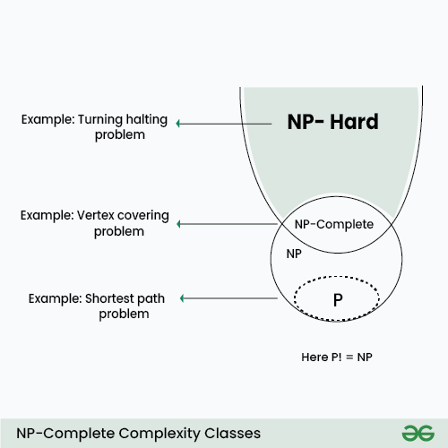
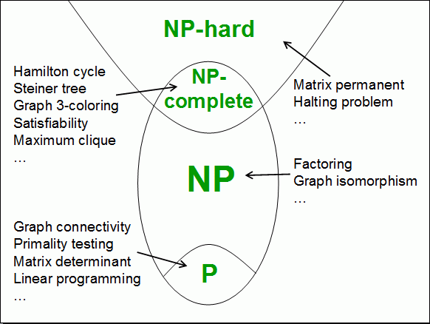

Slide 39
The End!!

